Slide 1

Understanding the Influence of Bank Deposit Growth on Sectoral Stock Market Performance in India
Supervisor:
z
Presented by:
A (20230)

Slide 2
Contents
Introduction
Literature Review
Objectives
Stock Market Anomalies
Machine learning Models used
Methodology
Results
Conclusion
References

Slide 3
Introduction
India’s household savings traditionally favoured bank deposits
Rise of equity participation since 2015; demat accounts tripled
Govt concern: market risks, banking liquidity
Research Question: Does deposit growth influence IT and Bank sector returns?
Govt concern: market risks, banking liquidity

Slide 4
Literature Review
Title | Findings | Limitation | Future Scope
A systematic literature review of unsupervised learning algorithms for anomalous traffic detection based on flows | While focused on network traffic, this paper provides a review of unsupervised learning algorithms relevant to anomaly detection, including autoencoders and SVM, which are also used in financial anomaly detection. It highlights the ability of unsupervised methods to detect unknown anomalies and their efficiency in not requiring labeled data.. | The paper is specific to network flow data and does not directly address the nuances of financial markets. | The review identifies research gaps and future directions in unsupervised anomaly detection, which could inspire new approaches in the financial domain.
Anomaly detection in stock market indices with neural networks | This paper employs a recurrent neural network (RNN) to detect anomalous behavior in several stock market indices using daily data. The approach identifies outlying realizations of log-returns. | The study focuses on RNNs, a specific type of neural network, and might not cover the breadth of unsupervised ML techniques. | The research demonstrates the potential of neural networks in identifying economically significant anomalies in stock market dynamics..

Slide 5
Title | Findings | Limitation | Future Scope
Unsupervised Learning for Anomaly Detection in Financial Markets and Crisis Prediction | This study demonstrates that unsupervised learning models (autoencoders, isolation forests, clustering algorithms) can effectively detect financial anomalies and provide early warnings for financial instability. | The abstract suggests a need for future research to focus on practical applications in financial risk assessment and automated monitoring systems. | The paper recommends future work should explore the practical application of these models for financial risk assessment and market stability monitoring.
Experimenting with Machine Learning for Stock Market Anomaly Detection | This research compares ARIMA, Isolation Forest, and One-Class SVM for stock market anomaly detection on Tesla (TSLA) and Bank of America (BAC) data. It found that Isolation Forest identified a broader range of anomalies (irregular price spikes and volume surges) than ARIMA, while One-Class SVM struggled. A hybrid approach of ARIMA and Isolation Forest is suggested for more comprehensive detection. | The study notes that no single model performed best across all market conditions and that One-Class SVM struggled with noisy financial data. | The findings suggest the potential of combining statistical forecasting with machine learning techniques to enhance anomaly detection in financial time series.

Slide 6
Research Objectives
3.
2.
1.
The primary objective of this research is to develop a machine learning-based framework to detect anomalies in financial time series, specifically focusing on Adani Group stock data.
The study aims to apply unsupervised learning models—DBSCAN, Isolation Forest, and Local Outlier Factor (LOF)—to identify irregular price, volume, and return patterns without relying on labeled data. Additional goals include comparing model outputs, identifying high-confidence anomalies (via model consensus), and analyzing how these anomalies relate to significant market events.
The final objective is to ensure the model is both scalable for large datasets and interpretable for practical use by analysts, traders, and regulators.

Slide 7
Stock Market Anomalies
Momentum Effect – Stocks that have performed well recently tend to continue rising (short-term trend continuation)
Mean Reversion – Extremely high or low prices tend to return to their average over time
Calendar Effects – Price patterns based on time (e.g., “January Effect” where stocks tend to rise in January)
Volume Spikes – Sudden, abnormal increases in trading volume indicating unusual activity
Event-Driven Anomalies – Irregular behavior caused by earnings announcements, political events, or reports (e.g., Hindenburg Report on Adani)

Slide 8
Machine Learning Models Used
DBSCAN
Detects anomalies as points that do not belong to any dense cluster
Effective in identifying grouped outliers and handling non-linear structures
Local Outlier Factor
Isolation Forest
Uses random partitioning to isolate anomalies
Suitable for high-dimensional and noisy financial data
Measures local density deviation from neighbors
Flags data points with significantly lower density as anomalies
Useful for detecting contextual or local anomalies
Anomalies require fewer splits to isolate and have shorter average path lengths

Slide 9
Methodology
Historical stock data for Adani Group companies was collected via Yahoo Finance using the yfinance API
The data was pre-processed by cleaning missing values, removing duplicates, and normalizing features such as returns, volume, and technical indicators. Feature engineering included the computation of RSI, Simple Moving Averages (SMA), Bollinger Bands, and daily returns, which were standardized to enable fair distance-based computations.
Three unsupervised models were implemented: Isolation Forest, which isolates anomalies through random partitioning; Local Outlier Factor (LOF), which identifies points with locally low density; and DBSCAN, which detects anomalies as noise points outside dense clusters.
Finally, the anomalies were interpreted through visual overlays on price data and compared with significant market events to evaluate practical relevance.
The results from these models were analyzed individually and combined using logical condition (AND) to identify both broad and high-confidence anomalies.

Slide 10
Results

Slide 11
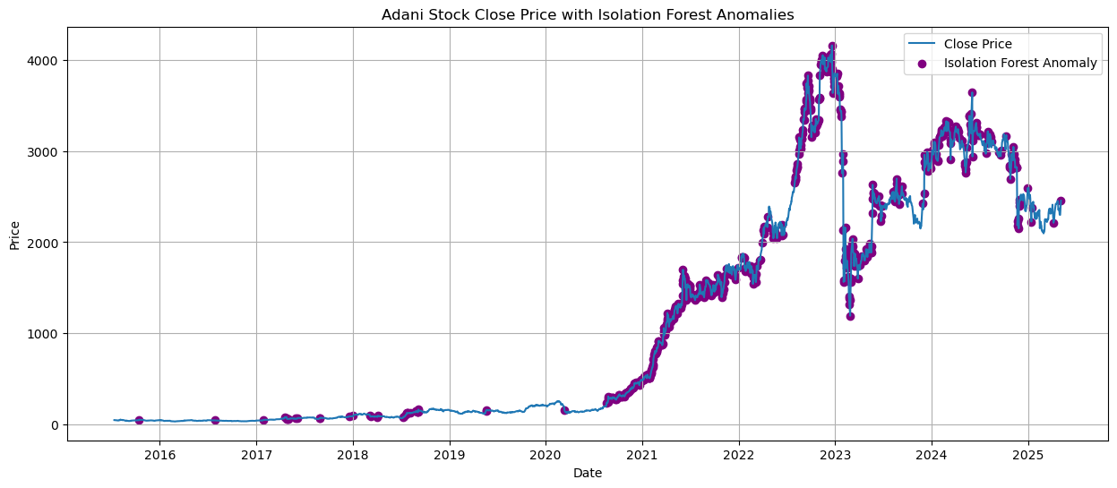
Model 1 – Isolation Forest
Interpretation:
Number of Isolation Forest Anomalies: 700
Isolation Forest effectively flags periods of unusual behavior, particularly event-driven volatility and irregular market momentum.
The model adapts well to historical patterns and avoids overflagging in low-volatility conditions.
These results are particularly useful for identifying periods where trading strategies should be adjusted or risk alerts triggered.

Slide 12
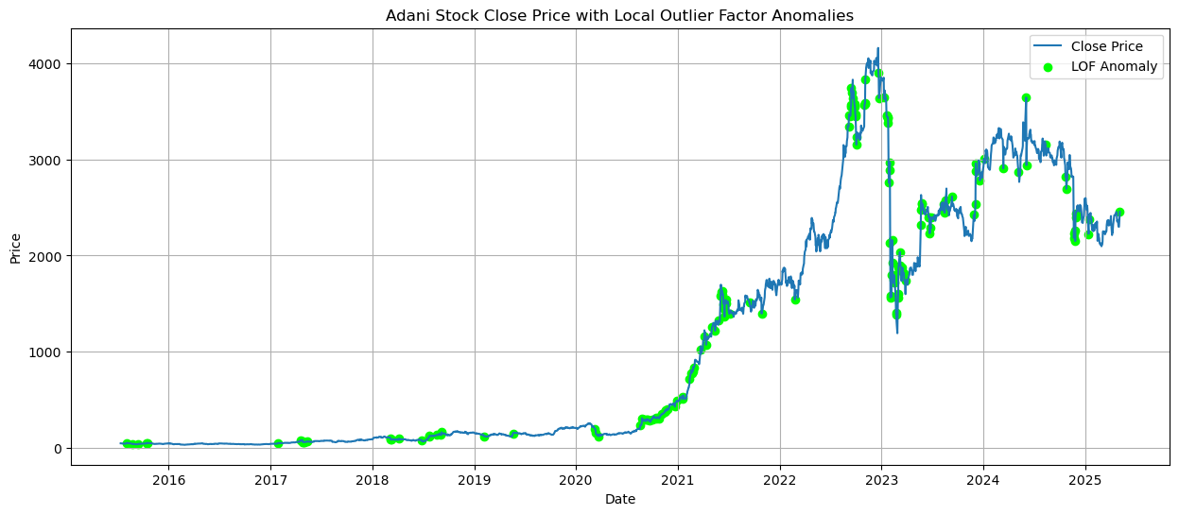
Model 2 – Local Outlier Factor (LOF)
Interpretation:
Number of Local Outlier Factor Anomalies: 166
LOF is sensitive to subtle deviations, making it good at flagging localized irregular behavior, even when broader volatility is low.
LOF excels in detecting behavioral turning points, such as the end of a trend or the beginning of instability.
This behavior shows LOF’s context-awareness—it doesn’t confuse strong momentum with abnormality.

Slide 13
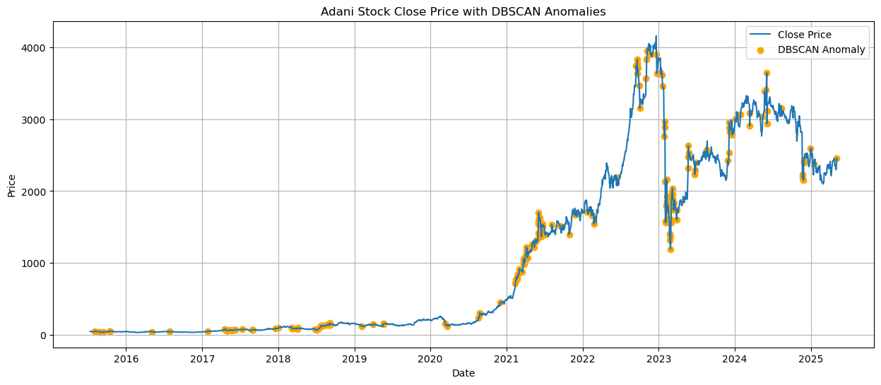
Model 3 – DBSCAN
Interpretation:
Number of Local Outlier Factor Anomalies: 194
DBSCAN is detecting isolated behavior patterns—not just extreme price levels, but moments that break the density consistency of surrounding data.
DBSCAN responds strongly to regime shifts and shock periods—ideal for identifying market instability.
This model avoids false positives during consistent directional moves, showing it respects underlying pattern continuity.

Slide 14
Model Comparison
Aspect | Isolation Forest | Local Outlier Factor (LOF) | DBSCAN
Type | Tree-based (partitioning) | Density-based (local deviation) | Density-based clustering with noise detection
Learning Type | Unsupervised | Unsupervised | Unsupervised
Sensitivity | High for global outliers | High for contextual/local anomalies | Medium-high for isolated or sparse clusters
Strengths | Fast, scalable, handles high-dimensions | Captures subtle deviations in local density | Identifies clusters and true outliers
Limitations | May over-flag in volatile series | Sensitive to neighborhood size | Requires careful tuning of eps and minPts
Detected Anomalies (Count) | 700 | 166 | 194
Overlap with Others | Medium | High overlap with DBSCAN | High agreement with LOF in volatile zones
Best Use Case | Catching large global spikes | Detecting subtle local shifts | Event-driven volatility and clustering

Slide 15
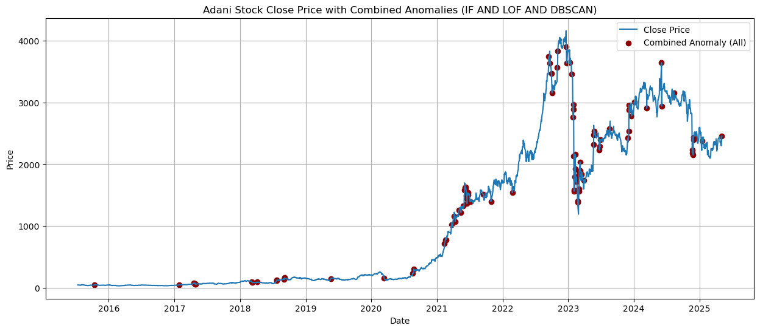
Combined Anomaly Detection
Interpretation:
Number of Local Outlier Factor Anomalies: 100
The consensus method (AND logic) effectively filters noise and isolates true structural market outliers.
These points coincide with event-driven volatility and market uncertainty, affirming the model’s practical reliability.
Combined anomaly detection avoids overfitting and ensures precision over quantity.

Slide 16
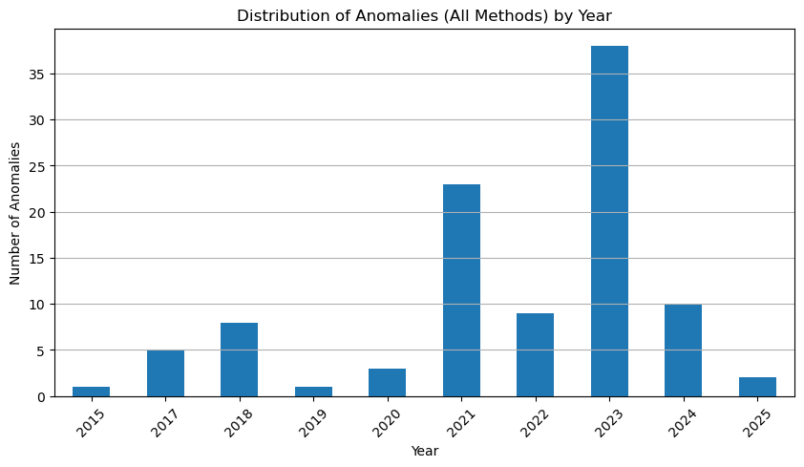
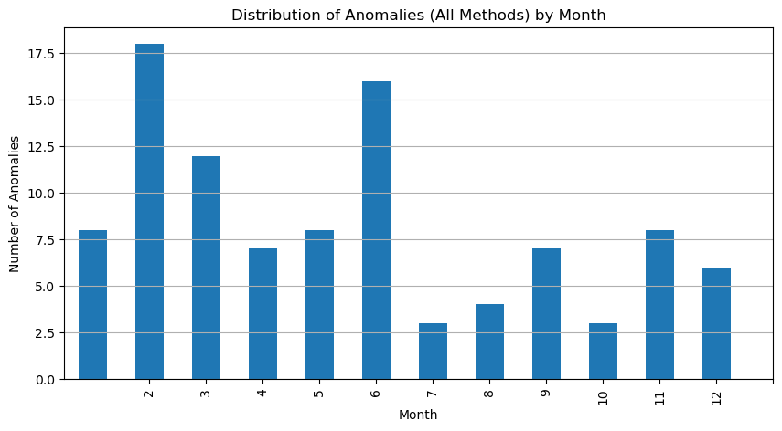
Time-Based Analysis of Combined Anomalies
Interpretation:
This spike in 2023 aligns with the Hindenburg short-seller event, which triggered market-wide disruption. 2021's spike likely reflects increased speculative activity and price reversals after the pandemic recovery phase. These results confirm that anomalies are temporally clustered during periods of heightened uncertainty or event-driven volatility.
The concentration of anomalies in February and June may correspond to financial disclosures, post-budget market reactions, or institutional rebalancing periods. This supports the relevance of calendar effects in stock market anomaly detection and justifies time-aware feature engineering in financial ML models.

Slide 17
Conclusion
This study presented an unsupervised machine learning framework for detecting anomalies in stock price behavior, focusing on Adani Group stocks. By applying three complementary models—Isolation Forest, Local Outlier Factor, and DBSCAN—the framework successfully identified abnormal patterns linked to volatility, reversals, and market events. Combined anomalies, confirmed by all models, showed strong alignment with real-world disruptions, particularly the Hindenburg report in 2023. The approach proved effective in handling non-linear, high-dimensional financial data, offering a scalable and interpretable solution for investors, analysts, and regulators. Overall, the results demonstrate that machine learning-based anomaly detection can enhance traditional risk monitoring and event analysis in dynamic financial markets.

Slide 18
Refrences
Azevedo, V., & Hoegner, C. (2022). Enhancing Stock Market Anomalies with Machine Learning. Journal of Risk and Financial Management, 15(9), 412. https://doi.org/10.3390/jrfm15090412
Albu, L. L., & Lupu, R. (2020). Anomaly Detection in Stock Market Indices with Neural Networks. Romanian Journal of Economic Forecasting, 23(2), 100–116.
Ravi, V., & Shamsuddin, S. M. (2021). A survey on anomaly detection in stock markets using machine learning. Expert Systems with Applications, 180, 115090. https://doi.org/10.1016/j.eswa.2021.115090
Zhao, Y., Nasrullah, Z., & Li, Z. (2019). PyOD: A Python Toolbox for Scalable Outlier Detection. Journal of Machine Learning Research, 20(96), 1–7. https://www.jmlr.org/papers/volume20/19-011/19-011.pdf
Chandola, V., Banerjee, A., & Kumar, V. (2009). Anomaly detection: A survey. ACM Computing Surveys, 41(3), 1–58. https://doi.org/10.1145/1541880.1541882
Aggarwal, C. C. (2016). Outlier Analysis (2nd ed.). Springer. https://doi.org/10.1007/978-3-319-47578-3
Fama, E. F. (1970). Efficient Capital Markets: A Review of Theory and Empirical Work. Journal of Finance, 25(2), 383–417. https://doi.org/10.2307/2325486
Hodge, V. J., & Austin, J. (2004). A Survey of Outlier Detection Methodologies. Artificial Intelligence Review, 22(2), 85–126.
Kou, G., Xu, Y., Peng, Y., & Shen, F. (2021). Machine learning methods for stock market prediction: A literature review. Expert Systems with Applications, 183, 115437. https://doi.org/10.1016/j.eswa.2021.115437
News Context: Hindenburg Research. (2023). Adani Group: How The World’s 3rd Richest Man Is Pulling The Largest Con In CorporateHistory.

Slide 19
Thank You

